Slide 1

Future Forward
Practicing Business analysis in the New Environment

Slide 2

Session Objectives
Challenges of working in a distributed environment
Changes that can be made to address those challenges
Techniques to use for improving results

Slide 3
Remote Working Tips floating Around Now
Remote workers are encouraged to:
Foster Real Relationships
Plan, Plan, Plan
Set Logistics in Place
Take Care of Yourself
Management is being encouraged to:
Commit to Organizational Transitions
Recognize that Going Digital Means More Than Just Using Technology
Strengthen a Culture of Inclusion
Be Authentic and Engage
Learn Together to Shape the Future of Work
Notes:
Sources – SkillCrush, Google, Inc., Bonusly Blog Post, World Economic Forum
Foster Real Relationships
Purposefully engage with your colleagues
Have regularly scheduled on-line meetings
Meet in person at regular intervals
Have a friend in the office
Plan, plan, plan
Prioritize purpose in your work
Be clear on expectations
Communicate progress
Create Process that work for you
Find a workaround for different time zones
Set Logistics in Place
Figure out the technology
Embrace video calls
Invest in a dedicated workspace
Designate a separate workspace
Don’t work in your pajamas
Find your productivity playlists
Figure out the schedule that works for you
Clearly explain the rules
Take Care of Yourself
Take regular breaks
A change of scenery can do wonders for your productivity
Embrace “Do Not Disturb”
Plan social interaction into your day

Slide 4
Challenges and Mitigation Approaches
Challenges
  Scheduling
  Non-verbal Communication
  Distractions
  Task Tracking
  Unplugging After Work
Mitigation
  Commitment to Efficient BA Plan
  Embrace Video
  Encourage Presence
  Accountability to the Plan, Issue Log
  Leave Dedicated Workspace

Slide 5
Seven Steps Journey Map

Slide 6
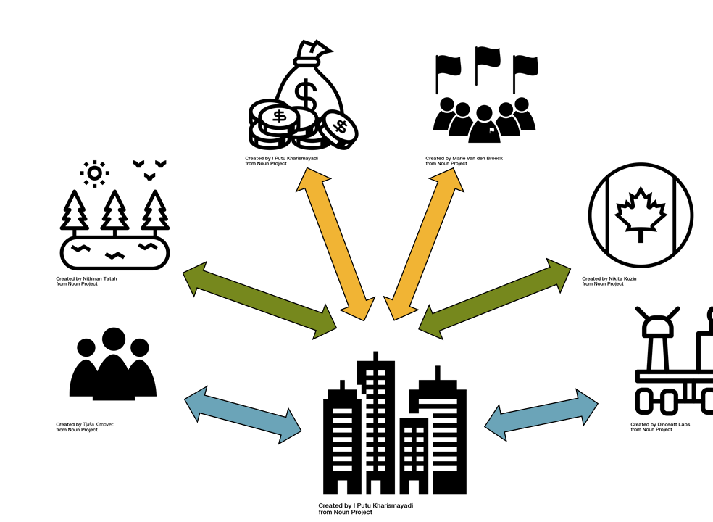
Steps 1&2 (Stakeholder Analysis & Business Context)
Do your homework – more than ever
  Document analysis
  Interviews (1-1, Group)
Test your findings
  Corroborate results
  Validation of results
Foster on-going stakeholder engagement

Slide 7

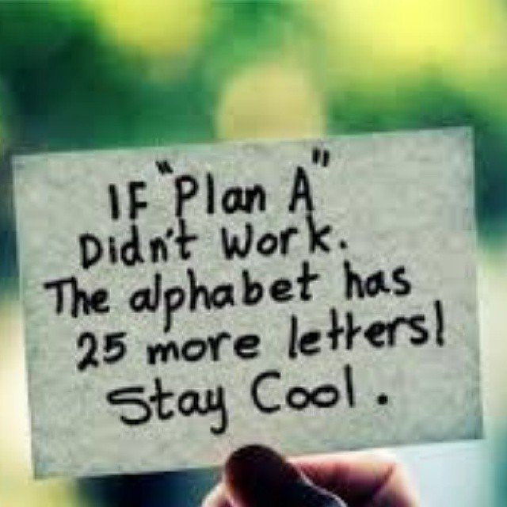
Step 3 (Planning)
BA Work Plan
  Incorporate elicitation research techniques to ensure efficient use of stakeholders’ time
  Consider the environment and incorporate visual engagements with stakeholders
  Encourage collaborative techniques and tools
BA Information Management Planning
  Accessibility
  Currency
Stakeholder Engagement Plan
  Key to reach consensus

Slide 8

Steps 4&5 (Set Scope & Solution/Design Definition)
Elicitation and Collaboration
  Stage setting – process, ground rules
  Entertain to achieve focus
  Hands-on engagement
  Convert physical sessions to the virtual environment (seamlessly)
Analysis
  Real-time scrutiny
  Usability studies
  Consensus building

Slide 9
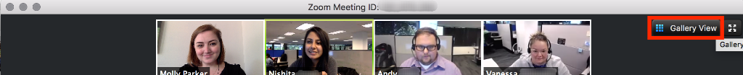
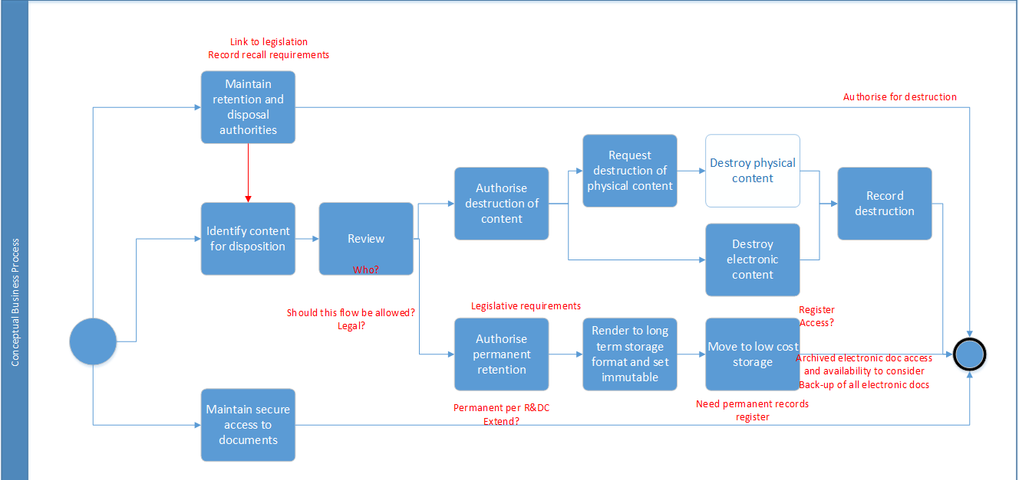
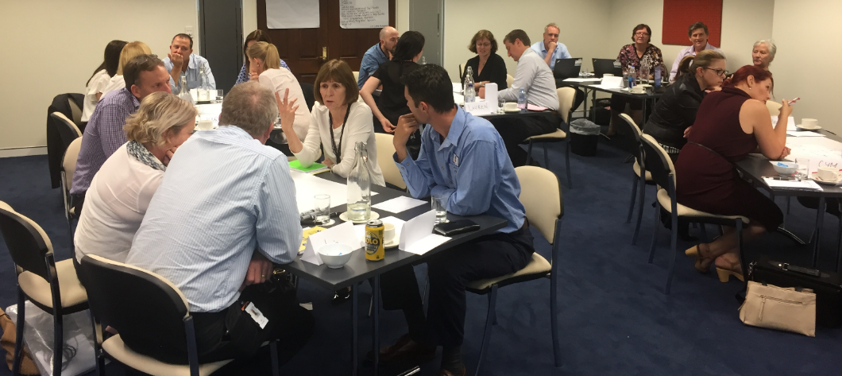
What Does This all Mean to practicing Business analysis?

Slide 10
Collaborative Elicitation – Ground Rules Required
Ground Rule Sampling
  Be on time (arrival, breaks, lunch, dismissal)
  Turn off Cell Phones/Blackberries
  No Interrupting
  No Side Conversations
  Leave Your Title at the Door
  No Beating a Dead Horse
  Attack Ideas, not People
  Don’t Pave the Cow Path (think outside of the box)

Slide 11

+ Ground Rules for Virtual Meetings
Stay in quiet areas to minimize background noise
Place on mute when not speaking
Stay close to the speakers if using speaker phones
ID yourself when speaking
Listen for facilitator calling on you for a question
Speak clearly, slowly, and avoid slang if English is not the first language of some participants.
If you have a strong accent, Southern, New Jersey, Boston or Foreign, please speak slowly
Minimize fiddling with things near the speakers
Embrace the video

Slide 12
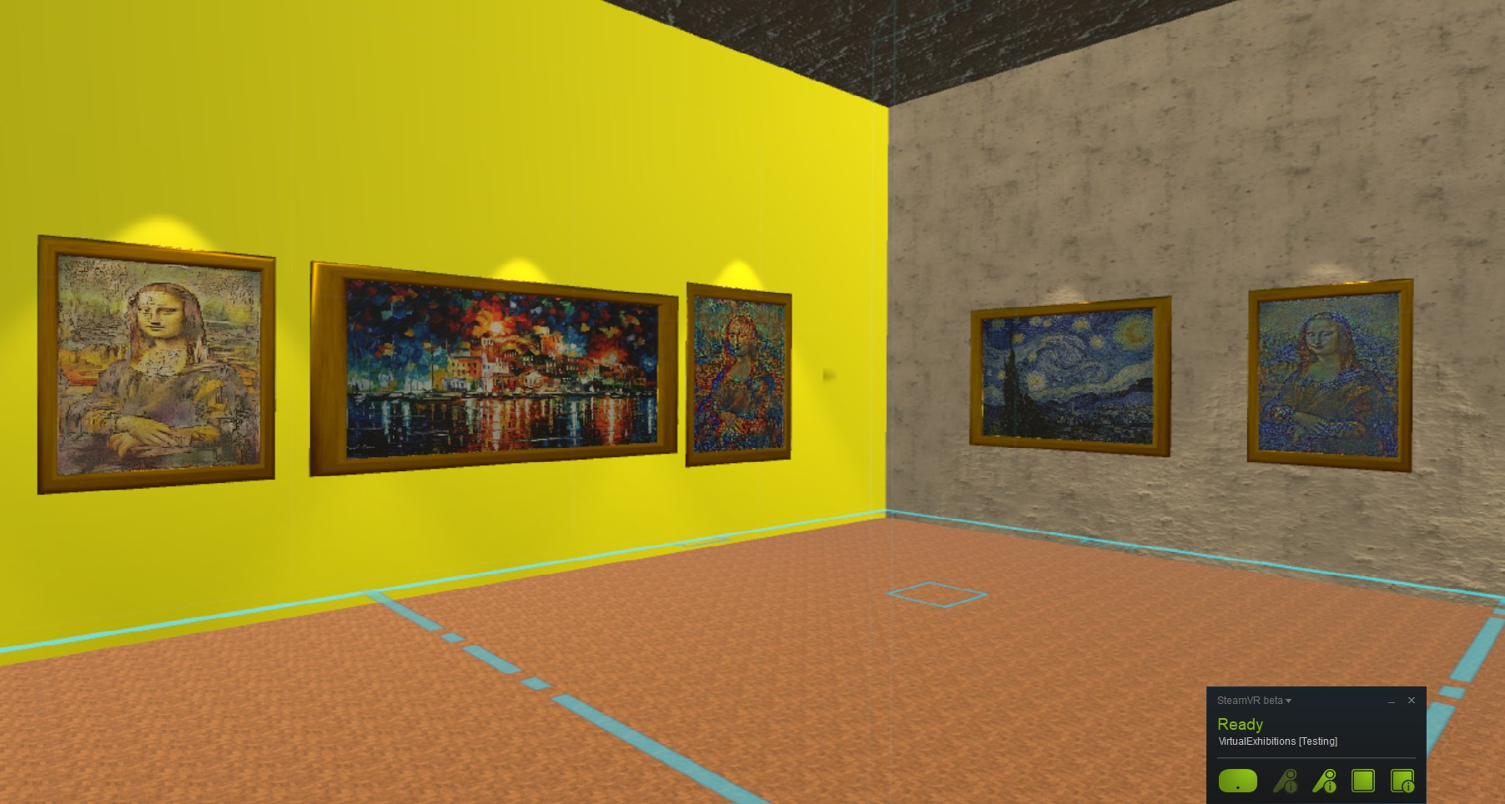
Step 6 (Manage Scope)
Verification, Validation and Approval – Set Up Virtual Project Room
Requirement Allocation and Solution Recommendation – Invite Yourself
Monitor Requirements and Design Definition – Document Tracking & Tracing
Scope Changes – Follow the Plan

Slide 13

Step 7 (Solution Evaluation)
Provide Solution Design Feedback
Requirement Allocation Support
Solution Team Support
Monitor and Evaluate Solution
Organizational Readiness

Slide 14
Summing It up
Challenges of working in a distributed environment
Changes that can be made to address those challenges
Techniques to use for improving results

Slide 15

Conclusions
Notes:
Remote working brings a lot of potential benefits to the table but you’re never going to get to a point where you can enjoy these unless you achieve a level of productivity and discipline that helps achieve a work-life balance. There’s not much point in working remotely if your job starts eating into your personal life and vice versa.
That divide needs to remain in place and this can be challenging if you work from home or remote locations. We’ve looked at ten of the most common remote work challenges in this article and solutions to overcome them.
Now, the rest is up to you.

