Slide 1
Data Analytics and AI
Empowering BAs for Data Analytics (using AI)

Slide 2
Agenda
Introduction
IIBA Data Analytics Certification (CBDA)
AI and the CBDA Knowledge Areas
Questions/Wrap Up

Slide 3
Who am I?
Tom Tomasovic
Senior Consultant
Tableau Desktop Specialist, ICA-APO, IIBA®-AAC, -CPOA, -CBDA, -CCA, -ECBATM, AgileBA® Practitioner, CPRE-FL, SFC
Location: Delaware, OH
Professional experience:
20+ yrs as a professional singer in opera, oratorio, and musical theater
20+ yrs of software development, analysis and management
Instructor for: Adaptive US, IAG Consulting, RGFreeman Group, IIL, The New School
Courses: BA Fundamentals, Foundations of Business Analysis, BA Bootcamp, AAC, CBDA, CPOA, ECBA
Hobbies:
Pocket Billiards (straight pool, 8-ball, 9-ball), travel, wine, cooking, gardening
Notes:
1st – 6/9/19
59 4/13/2020

Slide 4
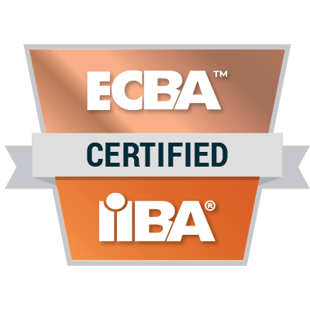
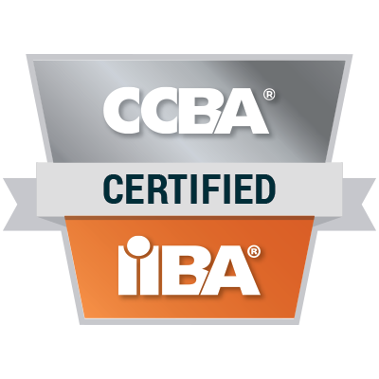
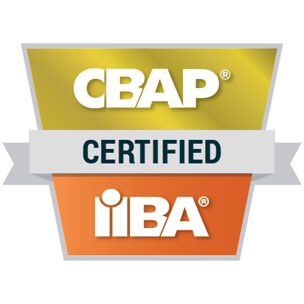
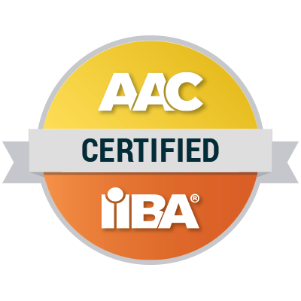
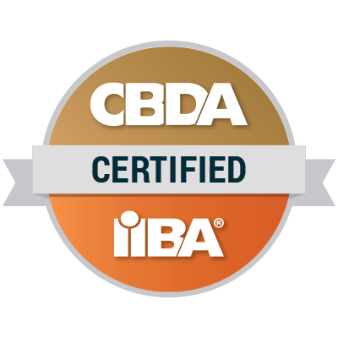
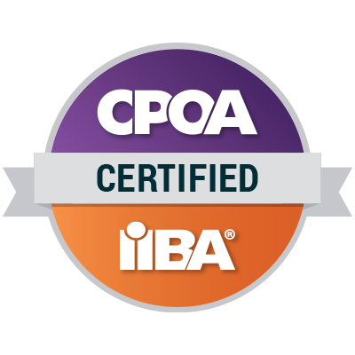
IIBA Certifications
Core Certifications
Specialty Certifications
Notes:
As of December 2023? – 24,661
IIBA® - AAC: ​762
IIBA® - CBDA: 304
IIBA – CCA: 373
IIBA®- CPOA: 880
CCBA®: 1,274
CBAP®: 11,418
ECBA™: 11,241

Slide 5
Data Analytics Domains
Identify Research Questions (Domain 1)
Source Data (Domain 2)
Analyze Data (Domain 3)
Interpret and Report Results (Domain 4)
Use Results to Influence Business Decision Making (Domain 5)
Guide Company-level Strategy for Business Analytics (Domain 6)

Slide 6
Identify Research Questions
Purpose: Provide focus and shape work
Tasks:
Define business problem or opportunity
Identify and understand stakeholders
Assess current state
Define future state
Formulate research questions
Plan business data analytics approach
Select suitable techniques
Notes:
Problems are identified instinctively or organically

Slide 7
Identify & Understand Stakeholders
Prompt: As a project-oriented business analyst for a provider of online training for IIBA certifications, how can you help me to identify and understand stakeholders for an initiative to increase our sales volume?
Response: I can augment the BA's expertise by providing large scale analysis of data, monitoring competitive landscape, automating repetitive tasks, and accelerating reporting and ideation.
Notes:
Here are some ways I could help you as a business analyst identify and understand stakeholders for an initiative to increase sales volume of IIBA certification online training:
- Conduct stakeholder analysis to identify individuals/groups that would be impacted by or influential to the sales initiative. This could include:
- Internal stakeholders - sales team, marketing team, product team, customer support, executives
- External stakeholders - current customers, prospective students, certification boards, competitors
- Interview or survey key stakeholder groups to gather requirements and perspectives:
- Sales team - understand challenges, needs, ideas to improve sales
- Current students - satisfaction, likelihood to recommend, additional courses of interest
- Prospective students - awareness of offerings, factors influencing provider choice
- Competitors - analyze their offerings and identify competitive advantages
- Facilitate workshops with sales team to map out their process and identify pain points or opportunities
- Send out surveys and review data and feedback from current students to understand satisfaction levels and improvement areas
- Review marketing analytics data to identify trends in acquisition channels and effectiveness
- Develop empathy maps and buyer personas to capture key details on stakeholder groups
- Document key findings from stakeholder analysis in a stakeholder register that outlines their interests, expectations, and level of influence
- Present insights to product team and executives with recommendations for high priority opportunities to increase sales volume based on stakeholder needs
- Set up regular touchpoints with stakeholder groups to validate solutions and gather continuous feedback

Slide 8
Identify & Understand Stakeholders
Prompt: Can you analyze and summarize the following data (150+ customer reviews)?
Response: In summary, the core exam preparation approach is sound but refinements to content, technology, and customer service will optimize satisfaction and training effectiveness. This requires continual solicitation and incorporation of customer feedback.
Prompt: Can you elaborate on these recommendations?

Slide 9
Identify & Understand Stakeholders
Training Approach
- The overall training approach including knowledgeable instructors, comprehensive study materials, exam simulations, and support is highly effective for IIBA exam preparation and success. This should continue to be the core focus.
- Spread out delivery of materials more evenly across training sessions to avoid cramming key concepts at the end.

Slide 10
Identify & Understand Stakeholders
Content Refinement
- Add more examples, visuals, and real-world scenarios to study guides and presentations.
- Release new content, simulated exams, and question banks more frequently to stay current.

Slide 11
Identify & Understand Stakeholders
Technology Experience
- Resolve website functionality bugs to improve access to purchased materials.
- Enhance platform aesthetics, navigation, and mobile-responsiveness.
- Build in features like progress trackers, test performance percentages, shuffled test questions, and simplified login.

Slide 12
Identify & Understand Stakeholders
Customer Service
- Continue prompt, helpful, polite support throughout cert process.
- Address student frustrations and suggestions for improvement to enhance loyalty.

Slide 13
Source Data
Purpose: Understand the context of the problem and determine what type of data must be used
Tasks:
Plan Data Collection
Determine the Data Sets
Collect Data
Validate Data
Notes:
Understand the context of the problem and determine what type of data must be used:
AI can analyze textual data, such as customer feedback, reviews, and industry reports, to understand the context of the problem and identify relevant data types.
Natural Language Processing (NLP) models can assist in extracting key information and patterns from unstructured data.
Plan Data Collection:
AI can help in creating data collection plans by analyzing historical data patterns and recommending appropriate data sources.
Automated planning algorithms can optimize the scheduling of data collection activities based on resource availability.
Determine the Data Sets:
Machine learning algorithms can assist in identifying relevant data sets by analyzing the relationships between different data variables.
AI can suggest external data sources that might complement internal data for a more comprehensive analysis.
Collect Data:
Automation tools can be used to collect data from various sources, including online platforms, surveys, and databases.
AI-driven data collection can ensure efficiency, accuracy, and real-time processing of large datasets.
Validate Data:
AI can implement data validation algorithms to check for inconsistencies, errors, and outliers in the collected data.
Machine learning models can learn from historical data validation patterns to improve accuracy in identifying valid or invalid data points.

Slide 14
Validate Data
Prompt: How do you see AI being able to assist a BA in validating data?
Response: I can support the BA by providing tools and quality control throughout the process. My ability to quickly synthesize large data volumes would be valuable for aggregating, assessing, and cleaning the data. Specifically, I can:
Assess data quality - completeness, accuracy, relevance
Identify any issues with data integrity or gaps
Recommend and implement data cleaning activities to resolve quality issues
Confirm final data sets meet requirements
Notes:
I could assist with formulating Power Query processes to prepare and clean the sales dataset as part of the Source Data domain tasks:
Analyze dataset to understand structure, data types, potential issues
Recommend categorizing or binning columns as needed (e.g. age groups, sales ranges)
Identify columns needing data type changes (e.g. strings to dates)
Suggest aggregating columns as appropriate (e.g. sum of sales by region)
Propose steps to clean data:
Fill blank values
Trim or clean text
Filter or remove duplicates
Handle errors
Merge disjointed data
Construct sample Power Query scripts performing required data transformations
Provide Power Query code snippets, templates, or examples as starting points
Give guidance on best practices for sequencing query steps
Assist with troubleshooting any issues with transforming or cleaning data

Slide 15
Validate Data
Prompt: Can you clarify the distinction between data validation and exploratory data analysis?
Response: The key distinction from exploration is validating that data meets quality standards before conducting analysis. This focuses on things like duplicate detection, profiling, lineage tracing, consistency, and identifying outliers. The goal is assessing fitness of data for purpose. Exploratory analysis instead focuses on extracting insights.

Slide 16
Validate Data
Prompt: Given that context, what specific action can you perform to assist in this process?
Response:
Instant Data Profiling - AI rapidly analyzes datasets to detect quality issues and inconsistencies.
Finding Duplicates - Identify duplicate records instantly even in massive datasets.
Assessing Completeness - Highlight fields with missing values across entire datasets.
Checking Consistency - Validate uniformity of data types, formats, and values across sources.
Tracing Data Lineage - Rapidly trace data origins and processing pipelines.
Detecting Anomalies - Flag unusual data points compared to expected value ranges.

Slide 17
Analyze Data
Purpose: Provide context to the problem or opportunity
Tasks:
Develop Data Analysis Plan
Prepare Data
Explore Data
Perform Data Analysis
Assess the Analytics and System Approach Taken
Notes:
Develop Plan
Decide how data will be analyzed, e.g.,
math/statistical techniques,
algorithmic models (leverage Data Analyst/Scientist!)
which data sets/sources, linking and joining data from different sources
decisions on how to clean the data (this may be an iterative process!) - more often than not, data is NOT clean!!
Prepare the data for analysis (SQL, Excel, data models, data dictionaries) –
normalization
standardization
scaling
converting
cleansing
Anecdotally, this can represent up to 80% of the time needed to perform effective data analysis. Much of this work is informed by the domain knowledge of the BA!
Explore Data - Preliminary basic analysis (data scientist, informed by business analysis context)
Data integrity: Can the data be trusted? For example, is the data structurally correct? (Are all my temperature sensors working? Do I have readings for all the planned time intervals? Are all employee IDs numeric? Are all birth dates valid for living employees?)
Data validity: Is the data truly representative of an underlying construct? Are my temperature sensors calibrated correctly? Are there unexplained outliers? Inconsistent values? Missing values? Do the sales totals in the dataset match the financial reporting?
Data reliability: If data is collected more than once, will the same results be obtained? For example, will a survey respondent answer a question differently on different days of the week?
Data bias: Does the data portray an accurate picture of a given situation? For example, are employees overestimating the quality of their work or do we have a situation where the survey participants are not a representative sample of the population? Are crime statistics skewed toward certain geographies (e.g., neighborhood) or demographics?
Perform Data Analysis - Exploratory analysis informs the process and methods used for in-depth analysis, which is intended to answer specific business questions via mathematical models or algorithms.
Assess Approach – Is the data helping to answer the question? Iteration!! BAs provide business context for data analysts/scientists

Slide 18
Analyze Data
Prompt: Assume that the analyst is capable of performing some of these tasks using tools like Excel. Other than speed of execution, are there specific areas where you feel human intervention, i.e., the domain expertise of the analyst, would not be warranted and you could add significant value to the process.
Response: My goal is to augment and enhance the human analyst for optimal analytical outcomes, not replace them entirely. The ideal human-AI collaboration minimizes repetitive and cumbersome tasks while leveraging each side's strengths.

Slide 19
Analyze Data
Automating data preparation - I could handle large volumes of data from disparate sources and automate joins, cleansing, transformations, etc. This is tedious work for analysts.
Identifying insights and relationships in the data that may not be obvious - With natural language processing and neural networks, I could surface non-intuitive insights and patterns in the data that a human analyst may miss.

Slide 20
Analyze Data
Keeping up with latest analysis techniques - As an AI, I have instant access to state-of-the-art analysis algorithms and can apply advanced techniques like predictive modeling, simulation, complex clustering, etc. that a human analyst may not be aware of.
Avoiding bias - I don't have inherent biases that a human analyst does. I can counteract confirmation bias, anchoring, recency bias, etc. and provide an impartial analytical perspective.

Slide 21
Analyze Data
Handling complexity - I can process many variables, large datasets, and consider vast permutations of analytical approaches beyond human capability. This allows for more comprehensive analysis.

Slide 22
Interpret and Report Results
Purpose: Explanatory rather than exploratory analysis
Tasks:
Validate Stakeholder Understanding
Plan Stakeholder Communication
Determine Stakeholder Communication Need
Derive Insights
Document and Communicate Findings
Select Techniques
Notes:
We first need to be certain that our stakeholders are prepared to consume and act on the results of our initiative. This can involve educational and other activities designed to inform them of our findings and insights, prior to communicating the actual results of the analysis.
Planning for Communicating the Insights:
Who are the key stakeholders for this initiative?
What are the specific interests and needs of each stakeholder group?
What are the most important insights or findings from the analysis?
How can we communicate these insights in a way that is clear and understandable to each stakeholder group?
What channels or formats of communication are most appropriate for each stakeholder group?
What is the desired frequency of communication for each stakeholder group?
How can we ensure that stakeholders have the necessary context and background information to understand the insights?
What potential barriers or challenges might arise in communicating the insights to each stakeholder group, and how can we address them?
How can we solicit feedback and input from stakeholders to ensure that the communication is effective and meaningful?
How can we ensure that stakeholders feel engaged and invested in the initiative throughout the communication process?
Interpreting Analytics Results: How are data patterns, trends, signals, and models translated to business insights in business language?
One of my data analytics instructors clearly stated that the purpose of data analysis is to identify interesting and actionable insights from the data.
Explaining the Findings:
What is the insight that needs to be communicated?
What is the best method of communication?
What is the right level of detail for each stakeholder?
What is the best way to record the results and feedback for future consumption?
Data visualization!! Best practices (pre-cognitive processing, preattentive attributes, gestalt principles) – Cole Nussbaumer Knaflic (storytelling with data), Tableau/Power BI communities

Slide 23
Interpret and Report Results
Prompt: Assume the BA is capable and focus your recommendations on areas where your unique capabilities would expand and extend what the BA could accomplish on their own.
Response: I can significantly augment the BA's analysis and synthesis abilities, enable more robust stakeholder engagement, and enhance the clarity and persuasiveness of reporting - ultimately leading to data-driven insights that better meet stakeholder needs. My unique strengths in data processing, analytics, and communication make me an ideal partner for this domain.

Slide 24
Interpret and Report Results
Validate Understanding of Stakeholders
I could review past communications and interactions with stakeholders to ensure we have a comprehensive view of their needs, concerns, and goals.
Plan Stakeholder Communication
I can suggest optimal methods, timing, frequency, and content formats for communicating results and insights.
Notes:
Here is a hypothetical example:
The project has two key stakeholder groups - the marketing team and the product team.
By analyzing emails, meeting notes, and other documents, I may identify that:
- The marketing team prefers short, visual summaries of insights with clear recommendations, ideally presented at their weekly team meetings.
- The product team is more technical and likes detailed data-driven presentations delivered through online dashboards they can explore on their own time.
- Marketing stakeholders have frequently requested clarification around metrics like customer lifetime value and churn rate in the past.
- The product team has asked questions about the statistical significance of certain experimental results.
With this context, I would recommend:
- Creating a 1-page visual infographic delivered through a short presentation for the marketing team on Monday mornings.
- Building an interactive dashboard allowing self-service exploration of results for the product team.
- Including definitions and examples for metrics like lifetime value and churn rate.
- Providing details on statistical tests and confidence intervals within the dashboard for the product team.
So in essence, yes - by maintaining records of past stakeholder communications and preferences, I could analyze these to determine optimal formats, level of detail, and examples tailored to each group for discussing the latest results and insights from the completed analysis.

Slide 25
Interpret and Report Results
Determine Communication Needs of Stakeholders
I can analyze stakeholder comments and questions to identify areas requiring further explanation or clarity. I can also gauge their level of technical understanding.
Derive Insights from Data
My analytical capabilities allow me to consider many more variables simultaneously compared to manual analysis.

Slide 26
Interpret and Report Results
Document and Communicate Findings
I can generate data visualizations, summaries, and translations of technical findings into layman terms for different audiences. I can create data-driven narratives to explain key takeaways.
Select Techniques for Interpreting and Reporting Results
I can recommend appropriate analysis techniques (statistical tests, predictive modeling, etc.) and reporting formats (graphs, charts, interactive dashboards, etc.) to optimize comprehension and impact.

Slide 27
Influence Business Decision Making
Purpose: Translate the analytics outcomes to business recommendations that the stakeholders and decision-makers can consume
Tasks:
Recommend Actions
Develop Implementation Plan
Manage Change
Notes:
Business analysis professionals are skilled at identifying solutions that:
align to the strategic direction of the organization,
are valuable,
provide a return for the needed investment, and
address stated KPIs.

Slide 28
Influence Business Decision Making
Prompt: How do you see an AI tool assisting a competent business analyst with these tasks, based on having acquired and analyzed the appropriate dataset?
Response: The key benefit is that the AI can take direction from the analyst and then rapidly produce supporting materials, project plans, and change management tools to bring the recommendations to life. This allows the analyst to focus on the critical thinking while the AI handles the tedious execution.

Slide 29
Influence Business Decision Making
Summarize key insights and recommendations The AI could take the analyst's findings and automatically generate slides, graphs, and talking points tailored for the audience.
Suggest potential actions or next steps The AI could review the data and results and propose ideas for implementing the recommendations, like changes to business processes, resource allocation, marketing campaigns, etc.

Slide 30
Influence Business Decision Making
Assist with developing an implementation timeline and change management plan The AI could help map out a detailed project plan for executing the changes.
Provide change impact analysis The AI could take a proposed implementation plan and analyze the potential impacts on people, processes, technology. This allows the analyst to anticipate pain points and resistance.

Slide 31
Influence Business Decision Making
Assist with developing an implementation timeline and change management plan The AI could help map out a detailed project plan for executing the changes.
Provide change impact analysis The AI could take a proposed implementation plan and analyze the potential impacts on people, processes, technology. This allows the analyst to anticipate pain points and resistance.

Slide 32
Influence Business Decision Making
Generate FAQs and training materials As new processes or systems are rolled out, the AI could quickly create documentation and education materials to get employees up to speed.
Offer continuous tracking and forecasting The AI can provide real-time dashboards, KPIs, and projection models to help the analyst oversee the implementation and make adjustments as needed.

Slide 33
Guide Strategy for BDA
Purpose: Embed analytics initiatives into the organizational architecture and overall decision-making framework
Tasks:
Organizational Strategy
Talent Strategy
Data Strategy
Notes:
Organizational strategy - Centralized/decentralized/hybrid
Talent Strategy – attract and retain high quality individuals
Data Strategy -
Data governance: the rules and policies that manage the data assets of an organization to ensure high-quality data.
Data architecture: the models and standards that govern how data is collected, stored, and integrated across an organization.
Data security: the activities performed to protect data from a privacy and confidentiality perspective.
Metadata management: the administration of information that is maintained about the data assets an organization collects and manages.

Slide 34
Guide Strategy for BDA
Prompt: This is an area where project-oriented BAs are unlikely to be involved, but senior BAs might have some influence. How do you see an AI tool being involved, particularly at the tactical level? The thrust here is how can AI assist/facilitate the involvement of a business analyst in helping to formulate organizational strategy, talent strategy, and data strategy. These are "macro" areas for the development of a comprehensive strategy for integrating business data analytics into the organization.

Slide 35
Guide Strategy for BDA
Response: The key is AI handles the detailed analysis and modeling work to provide actionable insights, freeing the BAs to focus on high-level strategic thinking.

Slide 36
Guide Strategy for BDA
Organizational Strategy: Analyze current organizational decision-making processes and structures. The AI could map out how decisions get made currently across units, levels, and functions. Model scenarios for restructuring/change. The BA could work with the AI to run simulations of different organizational scenarios and how analytics would fit. Suggest pilot opportunities. The AI can scan for areas ripe for an analytics pilot based on data availability, leadership interest, competitive need etc.
Notes:
Here is a hypothetical example of how an AI assistant could model organizational scenarios for adopting analytics in a training organization that uses independent contractors:
Current State:
- Training delivery is decentralized - contractors work independently without coordination.
- Minimal data collected on training effectiveness and customer satisfaction.
- No ability to benchmark contractor performance.
- Contractors are selected based on bids rather than performance data.
Scenario 1 - Centralized Analytics Model:
- Hire data analysts to collect and analyze training data centrally.
- Gather feedback, satisfaction scores, and adoption metrics from trainees.
- Build contractor performance profiles based on training outcomes.
- Develop standardized reports and dashboards for contractors and leadership.
AI could model the costs, skills, and technology needed for this scenario and the expected improvements in training quality and customer satisfaction.
Scenario 2 - Distributed Analytics Model:
- Provide contractors self-service analytics tools and templates.
- Contractors responsible for gathering their own metrics and insights.
- Implement basic data governance and quality standards.
- Enable contractors to share insights directly with leadership.
The AI could compare the costs and benefits of this more decentralized approach, where contractors own their own performance data.

Slide 37
Guide Strategy for BDA
Talent Strategy: Profile current analytics skills in the organization. The AI can survey employees and assess current skill levels to identify gaps. Recommend training/development. Based on skill profiles and gap analysis, the AI can suggest training programs and target roles for advanced analytics development. Forecast talent needs. The AI can model future analytics staffing and skill requirements based on the organizational strategy.
Notes:
I just recently saw an article talking about using AI effectively in the HR domain. The article talked about the reality of using AI tools for precisely what is mentioned (by AI) here!
“Back in the day”, organizations did not have the benefit of a tool that can gather, compile, and synthesize employee information based on surveys, performance reviews, training opportunities, and multiple other sources. As we move forward, all that information comes together to provide a holistic picture at the team and organization level.
The article flat out said that organizations that are not leveraging this capability are going to be at a competitive disadvantage in the war for acquiring and maintaining top level talent.

Slide 38
Guide Strategy for BDA
Data Strategy: Catalog existing data assets. The AI can rapidly analyze all current data sources, formats, and accessibility. Evaluate data quality. Assess completeness, accuracy, bias etc. in existing data to determine suitability for analytics. Recommend data governance policies. Based on analysis of current data, the AI can propose governance standards and policies to improve data for analytics. Identify needed data. Determine additional data types, sources, and access needed to enable desired analytics capabilities.
Notes:
When I worked for a healthcare provider several years ago, I used to joke about the diagram that detailed all our systems and applications and their interactions. I said it looked like the piping diagram for an oil refinery (my educational background was in chemical engineering).
Imagine having a tool that could effectively analyze all the complex interactions between multiple systems and applications, tracking where data is created and how it is transformed across the organization.
Imagine that same tool being able to identify areas of data vulnerability (where are all the places we store and manipulate sensitive information?).
Imagine that tool being able to ferret out the impediments to communication that plague organizations.

Slide 39
Guide Strategy for BDA
Prompt (revised): How can AI assist senior business analysts in developing organizational strategies for adopting business data analytics capabilities? Specifically, how can AI help with:
Formulating an organizational strategy that defines how analytics will provide insights, guide decisions, and be embedded in processes across the business units.
Developing a talent strategy to build the skills, staffing, and roles needed to execute the analytics strategy.
Creating a data strategy to govern, manage, and enrich data sources to enable reliable analytics.
Notes:
Finally, I asked my colleague (Claude) how I could have formulated my previous prompt to facilitate a better answer!
I think it’s pretty ironic that we can ask an AI tool how we can ask an AI tool to help us to do our jobs better.
There’s a lot of opportunity here, and we, as BAs need to embrace those opportunities. AI is not going away, and neither are we. Together, we can help our organizations (and ourselves) to continue to provide better services and products.

Slide 40
Questions

Slide 41
Keep in touch!
“I enjoy helping BAs do their job better!”
Email: t.m.tomasovic@gmail.com
LinkedIn: www.linkedin.com/in/tomtomasovic
Notes:
IIL-Webinar

Slide 42
For More Information
https://www.iiba.org/business-analysis-certifications/business-data-analytics-certification/
Certification training: https://shop.adaptiveus.com/?ref=tomtomasovic

Slide 43
Hope you enjoyed it!

